Slide 1
Student Part Time System Control Manual
Student handbook

Slide 2
Office of Student Affairs Privacy Protection Rule
KMU OSA in order to protect “Student Part Time ” rights, rule of “Personal Information Protection Act” from government hence is implemented. In hoping of getting your permission and trust, please be noted the regulations below:
Information Collected Content:
Collecting Unit: Kaohsiung Medical University Office of Student Affairs
Purpose: To manage student part time on campus.
Category: Student Identification
Valid Time: Till the end of the case or deletion required from applicants.
Valid Area: Taiwan
Information used by the Office of Student Affairs
Way to use: School online system and paperwork
Applicant can require to review, make duplicands, supplement, discontinue collection and delete personal information.

Slide 3
KMU Student Part Time Job Precaution
Qualification : KMU students
For those who are not reach 20 years old, a Consent Form from parents is needed.
For those who are interested in part time, please email your Name, Student ID to Mrs. Li n(chiyao@kmu.edu.tw), from the Division of Student Assistance.
Student have to log in to School Wac System, complete your resume and application at “D.2.4.01” , and wait for conformation.
Part Time job student must work within they leisure time , which cannot collide with they class time.
Salary will be counted by 158TWD per hours.
Labor Insurance will be counted as 244TWD, and will be deducted from the salary.
If students wish to quit the job, a resign letter will be needed to sign at KMU Personal Office .
Any question please seek to Mrs.Lin (ext. 2823)

Slide 4
Searching?
Part Time Job Opportunity
Salary
Sign In and Sign Out
Contract Details

Slide 5
Step 1
Log In

Slide 6
Step 2
Key In Student ID
Password

Slide 7
Submit resume and Part Time Job apply

Slide 8
Choose P.T job
Resume : briefly introduce yourself
Cell Phone number
Email Address
Student Identity: 外籍生

Slide 9
Step 3
Part Time Job Searching

Slide 10
Step 3
Vacancy occupied
Vacancy for the position
Contact Number
Working Content
Unit Code
Academic Year

Slide 11
Unit Code
Unit Code | Unit
A200 | Secretariat
A300 | Office of Accounting
A400 | Personal Office
A500 | Office of Academic Affair
A600 | Office of Student Affair
A700 | Office of General Affair
AS00 | Office of Library and Information Service
AF00 | Office of Research and Development
AT00 | Office of Global Affair
BB00 | Centre of Generation Education
F002 | Collage of Medicine
F003 | Collage of Dental Medicine
F004 | Collage of Pharmacy
F005 | Collage of Nursing

Slide 12
Unit Code
Unit Code | Unit
F006 | Collage of Health Science
F007 | Collage of Life Science
F008 | Collage of Humanities and social science
AU00 | Office of Operation of Industry and University Cooperation
AQ00 | Office of Environmental Health and Safety
AR00 | Auditing Office
AW01 | KMU Museum
A602 | Division of Student Assistance
A618 | Division of extracurricular Activity
A607 | Division of Health Service
A619 | Career Development Centre
A620 | Division of Psychology and Counseling
A604 | International Student
A606 | Mrs. Lai

Slide 13
Sign IN and Sign out

Slide 14
Sign IN and Sign Out

Slide 15
Sign IN

Slide 16
Sign Out

Slide 17
Salary Inquired
Salary will be banked in on 25 of next month

Slide 18
Payment Information

Slide 19
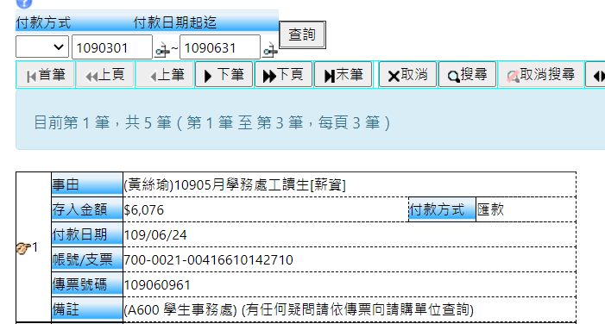
Bank IN amount
Bank IN Date
Student Account No

Slide 20
Contract Details

Slide 21
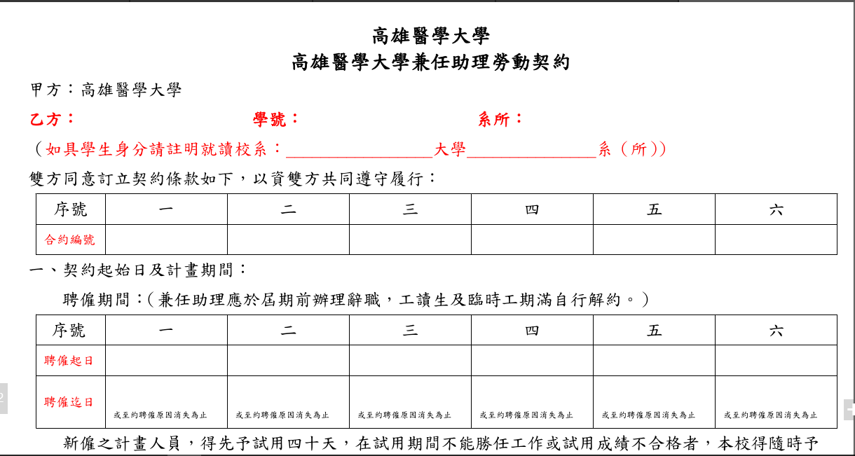
Student Details
Contract No.
Contract Valid Time

Slide 22
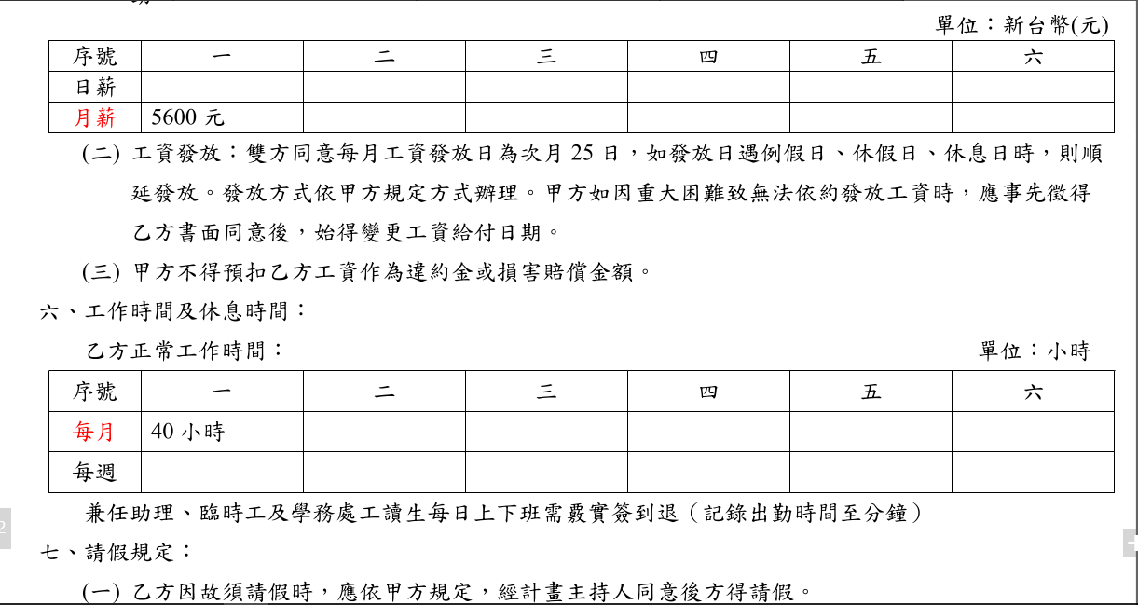
Monthly Salary
Monthly Working Hours

Slide 23
Name Birth Date(yyyy/mm/dd)
ARC No
Legal representative
Cell Phone number
Student Signature & Stamp

